Slide 1
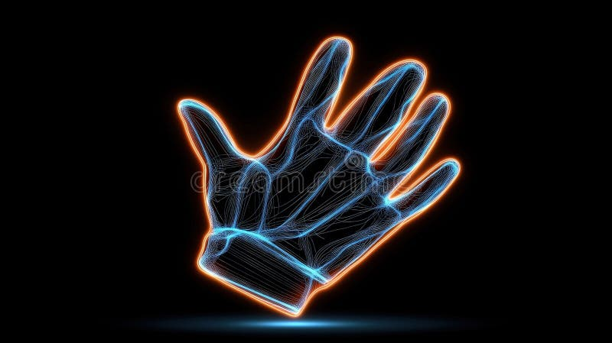
HACKATHON PROJECT 2025
Gesture AI
Bridging Silence with Technology
Real-Time Sign Language to Speech Translation Using Computer Vision & Machine Learning
Computer Vision
Machine Learning
Text-to-Speech
Next.js • MediaPipe • Web Speech API

Slide 2
The Challenge
A World Without Voice
Communication barriers create social isolation for millions of non-verbal individuals worldwide
Social Isolation
Market Opportunity
Non-verbal individuals face significant barriers in everyday communication—ordering food, asking for directions, or expressing emotions become daily challenges that lead to social exclusion and dependency.
Assistive Technology Market 2024
$33.25B
Projected Market 2035
$96.99B
Steep Learning Curve
CAGR (2025-2035)
10.22%
Learning sign language requires months of dedicated practice with limited feedback mechanisms. Without real-time correction, students struggle to master precise hand positioning and movement.
Communication Assistance is the fastest-growing segment in assistive technology
Interpreter Dependency
Professional interpreters are expensive and not always available. This creates barriers to education, healthcare, and employment opportunities for the non-verbal community.
The Gap: No accessible, real-time, web-based sign language translator exists that works across all devices without installation.

Slide 3
Our Solution
Gesture AI
Instant sign language translation powered by cutting-edge AI
Dual Purpose
Real-Time Translation
Zero-latency sign-to-speech conversion
Communication Aid
Gesture AI uses your device's camera to instantly recognize hand signs and convert them into natural, audible speech. No delays, no waiting—just seamless communication.
Enables non-verbal individuals to express themselves instantly in everyday situations
Learning Tool
Web-Based
Cross-Platform
Provides real-time feedback for students learning sign language, accelerating mastery
No installation required—works in any modern browser
Seamlessly adapts to mobile, tablet, and desktop devices
100% Free
Accessible
"Technology is most powerful when it empowers everyone. Gesture AI breaks down communication barriers and creates a more inclusive world."
Accessible to everyone—no subscriptions or hidden fees
WCAG 2.1 AA compliant for inclusive design

Slide 4
Technical Architecture
How It Works
End-to-end pipeline from camera input to speech output
1
2
3
4
Camera Input
MediaPipe Detection
Geometry Logic
Speech Output
User's hand is captured via device camera at 30+ FPS for smooth, real-time processing
Google's ML model detects 21 hand landmarks with 95.7% precision
Custom algorithms analyze joint distances and angles to classify gestures accurately
Web Speech API converts recognized signs into natural, audible speech instantly
Real-Time Performance
Privacy First
Edge Computing
Processes video feed at 30+ FPS with minimal latency
All processing happens locally in the browser
Runs efficiently on CPU without requiring GPU
No data leaves your device
Works on low-end devices
< 50ms response time
MediaPipe Hands: Industry-Leading Accuracy
30+
95.7% palm detection precision • 21 3D landmarks • Real-time mobile performance
FPS

Slide 5
Features
Comprehensive Recognition
Three-tier recognition system covering numbers, letters, and common words
Numbers
Alphabet
Common Words
0-9 Recognition
A-Z Static Letters
Pre-Trained Vocabulary
Full digit recognition enables counting, phone numbers, addresses, and basic mathematical communication.
Complete static alphabet recognition enables spelling names, words, and sentences letter by letter.
Pre-trained common words enable rapid communication for frequently used expressions and social interactions.
A
B
C
D
E
F
Hello
0
1
2
3
4
G
H
I
K
L
M
Thank You
5
6
7
8
9
N
O
P
Q
R
S
T
U
V
W
X
Y
Like / Love
Perfect for counting & quantities
Excludes dynamic J & Z
Expandable vocabulary
AR Overlay Feature
36+
99.5%
Detected characters are displayed directly on the user's hand in real-time for visual feedback
Recognizable Signs
Accuracy Rate

Slide 6
Technology
Tech Stack & Compliance
Modern, scalable architecture built with accessibility at its core
Frontend
APIs & Services
Next.js 15.5.9
App Router
Web Speech API
Text-to-Speech
TypeScript
Type Safety
MediaDevices API
Camera Access
Tailwind CSS
Dark Mode + Responsive
Accessibility
AI / ML
WCAG 2.1 AA Compliant
Meets international accessibility standards
Google MediaPipe
21 Landmarks
Keyboard Navigation
95.7%
Full keyboard control support
Detection Precision
Screen Reader Compatible
ARIA labels and semantic HTML
High Contrast Mode
Optimized for visual impairments
Privacy-First Architecture: All processing happens locally—no video data is sent to servers
0
100%
Server Calls
Local Processing

Slide 7
Applications
Dual-Purpose Application
Designed for both accessibility and education
Accessibility
Education
Communication Aid
Learning Tool
Enables non-verbal individuals to express themselves instantly in everyday situations, reducing dependence on interpreters and fostering independence.
Students learning sign language get real-time feedback on their hand positioning, accelerating the learning curve and making practice engaging.
Daily Interactions
Instant Feedback
Order food at restaurants, ask for directions, shop independently
Know immediately if your hand position is correct with AR overlay
Healthcare
Gamified Learning
Communicate symptoms, understand treatment plans, ask questions
Practice feels like a game with visual rewards and progress tracking
Workplace
Self-Paced Practice
Participate in meetings, collaborate with colleagues, advance careers
Learn anytime, anywhere without scheduling tutor sessions
Social Connection
Progress Tracking
Build relationships, express emotions, engage in community
Monitor accuracy improvements and celebrate milestones
466M
70M
2.5M
People with Disabilities Worldwide
Use Sign Language as Primary Communication
Students Learning Sign Language Annually

Slide 8
Live Demo
See It In Action
Real-time gesture recognition with AR overlay feedback
Application Interface
LIVE
Mobile Responsive
Confidence
Detected
98.7%
A
Works seamlessly on smartphones and tablets
Detecting Gesture...
Key Features
Position your hand in the frame
Dark mode interface
Real-time AR overlay
Adjustable speech rate
Speech Output
Confidence indicator
"Letter A"
Camera toggle controls
Camera Active
Speech Enabled
FPS:
32
Try It Now
No signup required—completely free

Slide 9
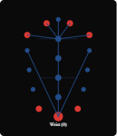
Algorithm
Geometry-Based Classification
How we distinguish visually similar signs with mathematical precision
The Challenge
21-Point Landmark Model
Signs like A , S , and T have visually similar closed-hand shapes, making them difficult to distinguish using simple image recognition.
A
S
T
Fist, thumb up
Fist, thumb in
Fist, thumb out
Our Solution
Custom geometry logic calculates normalized distances between 21 MediaPipe landmarks to create unique mathematical signatures for each sign.
1
Finger Tip to Wrist: Measures finger extension
2
Inter-Finger Distances: Detects spread patterns
3
Joint Angles: Identifies curl patterns
21
3D
95.7%
Landmarks
Coordinates
Precision
Performance Metrics
94.1%
30+
Classification Accuracy
FPS on CPU
Scale Invariant: Works with any hand size

Slide 10
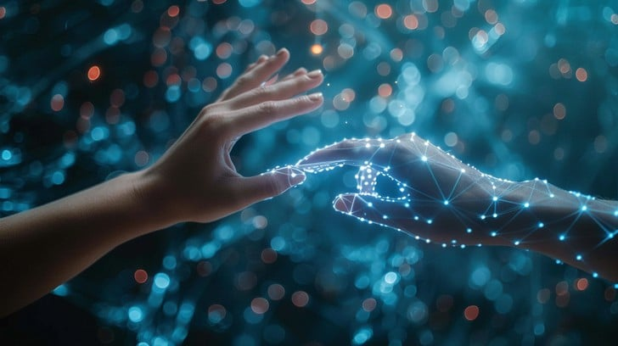
AI FOR SOCIAL GOOD
Breaking Barriers,
Building Connections
Gesture AI represents more than technology—it's a bridge to human connection. By leveraging cutting-edge AI to break down communication barriers, we're creating a more inclusive world where everyone's voice can be heard.
466M
100%
∞
People with disabilities worldwide who could benefit
Free and accessible to everyone, everywhere
Possibilities for inclusive communication
"The future is accessible, and it starts with gestures."
Join us in creating a world without communication barriers.
Open Source
Web-Based
Built with Love

